Slide 1
The Clean River Kent Campaign 2024 Open Event
Saturday 12th October 2024
Notes:
IS

Slide 2
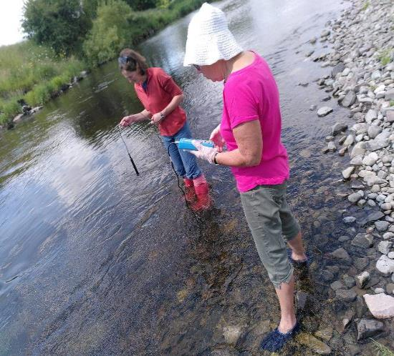
AGENDA
12.00pm Light lunch/introductions
12.30pm Welcome
Purpose of day
Quick national overview
12.40pm What CRKC volunteers have achieved so far in 2024?
1.00pm Introduction to the workshops
Break/Coffee
1.10pm Group discussions
2.10pm Review
General discussion
Conclusions
2.30pm Finish

Slide 3
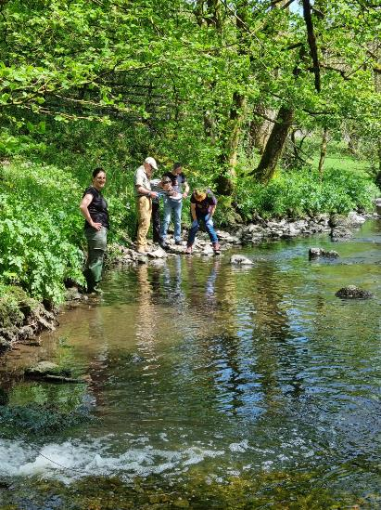
WELCOME
Purpose of day
1. Review progress this year
2. Get feedback
3. Discuss future plans
Notes:
IS

Slide 4
National Overview
Emerging national consensus re. wastewater services around the need to:
tackle failing water companies through special measures & special administration if necessary - leaving the debt with the water companies.
ensure that investment in water company assets is speeded up without above-inflation increases in customer bills - the targets for improvement must be brought forward, 2050 is too late for our water courses.
deliver effective environmental and financial regulation and enforcement.
use the existing legislation effectively and amend the current Water Bill to provide any further necessary measures.
End self-monitoring by water companies.
Speed up the introduction of 24/7 real time monitoring - the technology is available and needs to be rolled out.
There is increased awareness of the impact of negative land-use practices; plus increase of chemicals, pharmaceuticals and micro-plastics in our water courses.
Notes:
IS

Slide 5
A selection of media headlines in Summer 2024
Every water firm in England and Wales under investigation over sewage spills – The Guardian, 15 July
Calls for water firms to be 'punished' after revelations of sewage permit breaches – Sky News, 9 August
Thames Water boss handed huge bonus despite horror year – Mirror, 10 July
Fixing Britain’s sewage crisis is going to cost billions, but where is all that money coming from? – iNews, 12 August
UK water companies told to double compensation for outages – Bloomberg, 12 August
How polluted is your local river? Cocktail of almost 500 different chemicals found in waterways – ITV News, 6 August
Ofwat turns focus on United Utilities with probe into sewage disposal – The Business Desk, 16 July
Notes:
IS

Slide 6
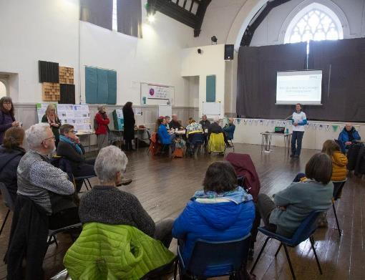
Objectives agreed at Spring ’24
Workshop:
Continue Citizen Science
Plan towards application for
bathing water status
‘Engagement’ with the River
Ongoing events
Election hustings
Other campaigning
Notes:
IS

Slide 7
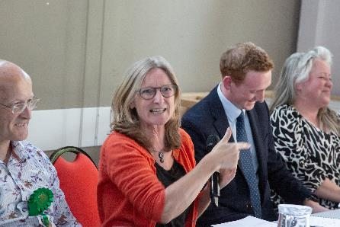
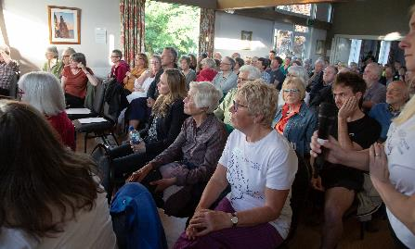
What have CRKC volunteers achieved so far in 2024?
General Election Hustings
Provided a platform for public to discuss water issues with candidates for Westmorland and Lonsdale
All 8 official candidates invited – 6 out of 8 attended
Cas Graham (BBC presenter/local Kendal resident) chaired
Around 100 people took part in the discussion
Notes:
IS

Slide 8
What have CRKC volunteers achieved so far in 2024?
CRKC Citizen Science Programme – completed 12 months of Freshwater Watch nutrient testing
Congratulations & thank you to everyone involved!
Results have been collated into a report with results for each site
240 samples, from 17 sites (excluding abandoned pilot sites), from 1 Sept 23 to 31 Aug 24 on:
the river Kent plus tributaries:
the river Gowan, Mint Spring, Lambrigg Beck, Underbarrow Pool
A significant data set that provides:
much information for FWW national database
a valuable baseline about the general health of the river & tributaries
a general indication of some ‘hot spots’ for further investigation
The citizen science workshop will introduce the findings in more detail, discuss what we do with the results, and how it informs future CRKC monitoring plans
Notes:
IS

Slide 9
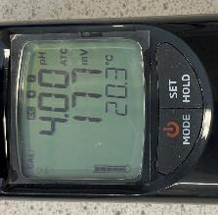
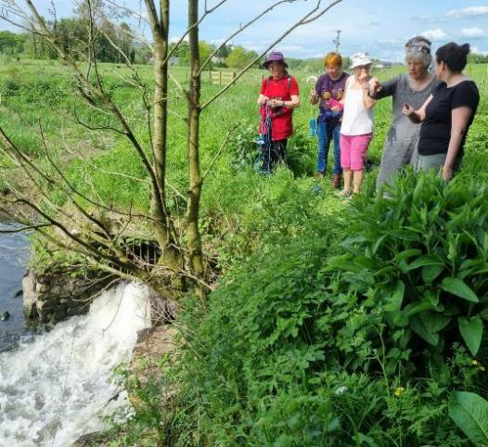
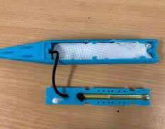
What have CRKC volunteers achieved so far in 2024?
CRKC Citizen Science Programme – Microbial Source Tracking with
University of Sheffield to assess the sources of faecal bacteria –
human/ruminants
Secured additional funding from Patagonia to extend the number
and type of tests, including UK first testing with ‘torpedos’
6 sets of monthly samples (May to October) collected & delivered
to Sheffield University lab.
Researchers currently analysing data – results due December
(academic publications(s) to follow)
Once CRKC has the results we will decide how best to use them
for campaigning purposes
CRKC spoke at national rivers conference in Sept to campaigners
from around the country about our citizen science programme
over the last 3 years
Funded by:
Woodleigh Impact &
Notes:
IS

Slide 10
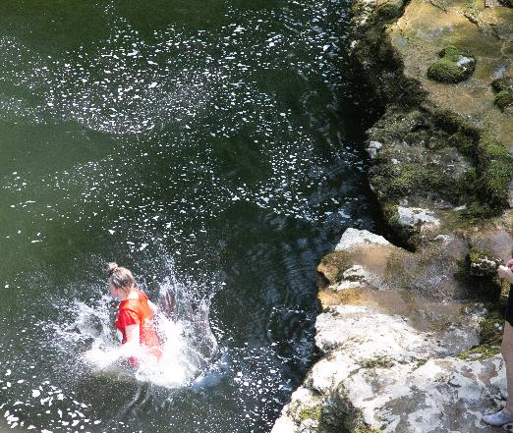
What have CRKC volunteers achieved so far in 2024?
Bathing Water Status – update
Research into stakeholders, development plans at Sandy Bottoms
Meetings with local authorities / councillors / UU to discuss the overall development of the area as a ‘green/blue’ nature hub in centre of Kendal
Link with Natural Kendal and the synergies with their plans
Decision to defer bathing status application to 2025 or 2026 based on timescales for development of site
Defra are reviewing the criteria – we have lobbied them to ensure these work for upland rivers and will meet with Defra officials to discuss our views along with other river groups
Notes:
IS

Slide 11
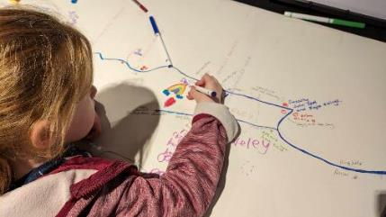
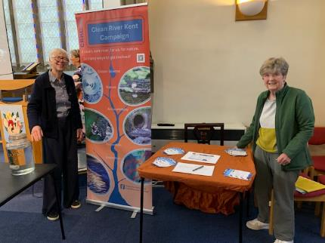
What have CRKC volunteers achieved so far in 2024?
Valuing & developing an emotional response to the river Kent
Banner and supporting leaflets that tap into different people’s interests – nature, science, politics, recreation.
2025 Calendar in production (campaigning messages to raise awareness & funds)
Attendance at several events, including Natural Kendal conference
Liaison with National Trust (Sizergh) re. production of walking leaflet (Kendal to Sizergh)
Link up with Morecambe Bay Partnership (Blue Influencers project) on river/water project with schools
Establishing links with other river supporters to share ideas – Protect our Rivers Facebook group
Notes:
IS

Slide 12
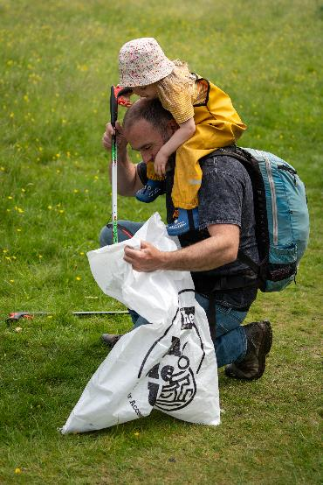
What have CRKC volunteers achieved so far in 2024?
Events / Talks / Meetings
Regular attendance at Kent Working Group
Regular attendance at Natural Kendal meetings
River Clean Up with Lakeland Canoe Club & Trash Free Trails
Attended Love Windermere march / plan to attend London
march on 3rd November - www.marchforcleanwater.org
Invited to speak at:
Kendal Town Council
Ilkley Conference - Cleaning up our Rivers, Lakes & Seas:
The Answers
Natural Kendal Conference
Notes:
IS

Slide 13
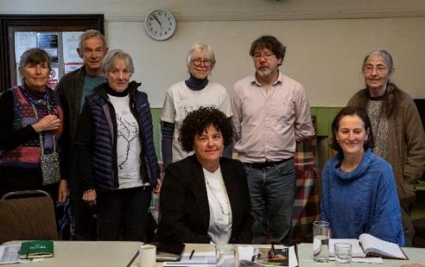
What have CRKC volunteers achieved so far in 2024?
Campaigning – Holding UU to account
Attendance at UU AGM
Scrutinising UU Draft Business Plan and Ofwat draft determination
Membership of Staveley Clean Water, Clean Streets Group to monitor progress
with scheme works supported by:
Continuing monitoring of river water quality
Ongoing monitoring at Staveley WwTW
Detailed modelling of water / sewage flows
Meetings with UU re. plans for Burneside Pumping Station
Visits to Staveley and Kendal WwTWs
Participation in national coalition of coastal and inland
water groups
Progress update meetings with:
Louise Beardmore (CEO – UU) and Team
W&F Councillors
Tim Farron MP
Support for other local campaign groups including
Love Windermere / national marches / new groups
Notes:
IS

Slide 14
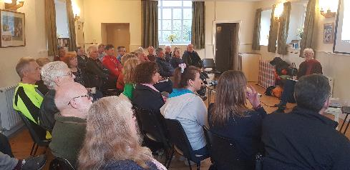
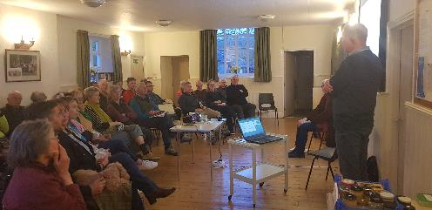
What have CRKC volunteers achieved so far in 2024?
Campaigning – Off-mains sewage treatment, individual actions
A well-attended CRKC talk about off-mains sewage (and individual household follow up by speaker)
Plans underway to create a series of information leaflets aimed at:
Householders
Septic tank / off-mains sewage owners
The leaflets will provide advice on what to do/not to do in the household to minimise contributing to river pollution, plus specific guidance / sources of further advice on how to ensure your off- mains sewage solution is well-managed.
Part of the Campaigning workshop discussion will be to brainstorm how CRKC can reach the widest audience with these leaflets, from householders to holiday cottage companies.

Slide 15
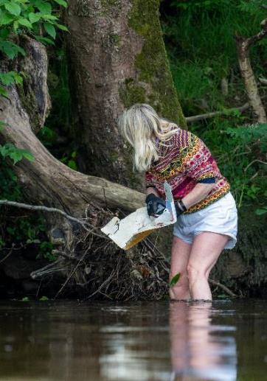
INTRODUCTION TO DISCUSSION GROUPS
To explore CRKC work priorities for 2024/25
GROUPS
Citizen Science
Emotional Response to River
Bathing water status
Campaigning & CRKC objectives
TIMINGS
1.10 – 1.40 Session 1
1.40 – 2.10 Session 2

Slide 16
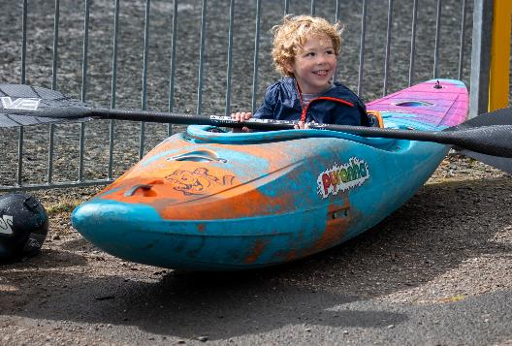
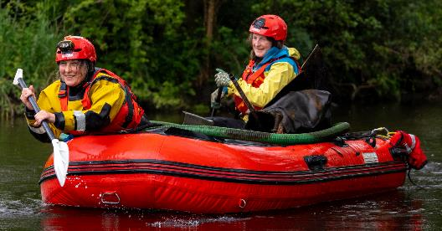
REVIEW
Feedback from groups
General discussion
Conclusions
Notes:
NB say thank you to Sheila and Mike – present card/present etc.

Slide 17
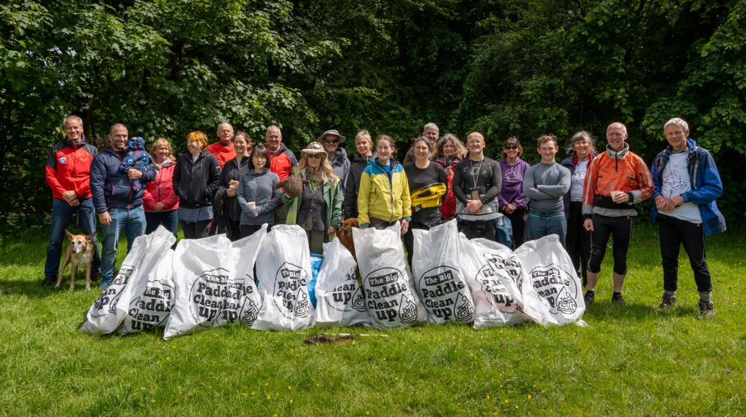
THANK YOU FOR COMING!

